Slide 1
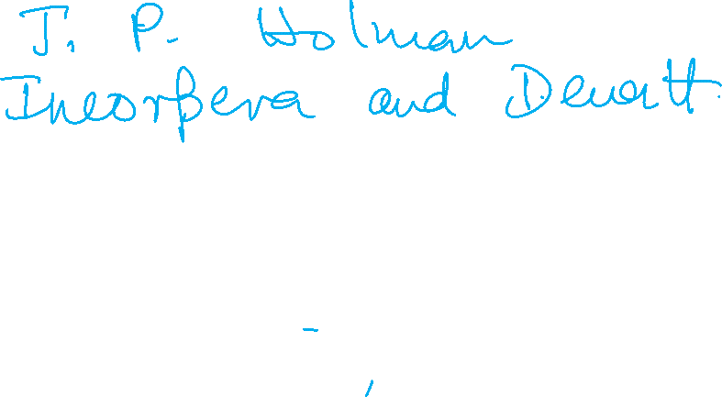
Heat Transfer (CH21204)
Conduction and Radiation

Slide 2
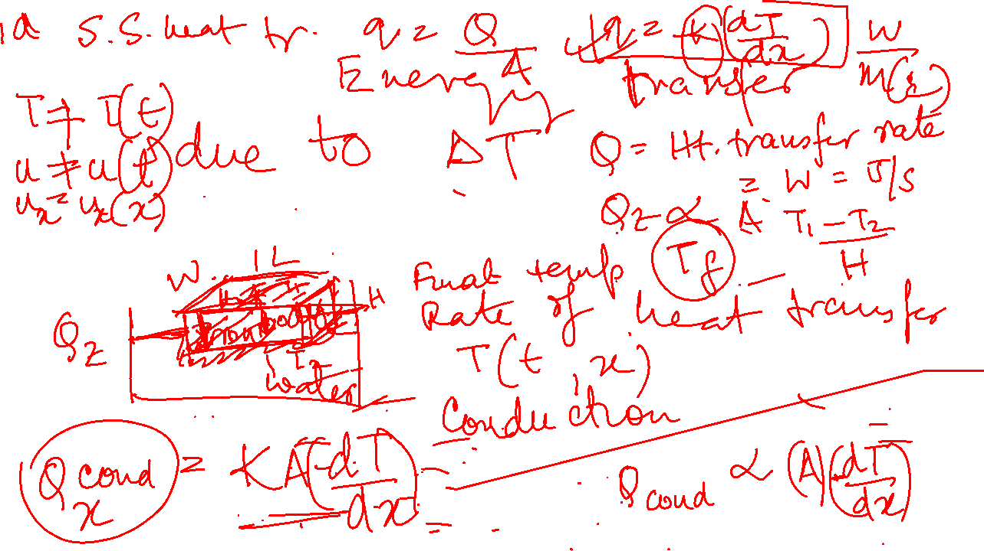
What is Heat Transfer ?
Difference between thermodynamics and heat transfer.

Slide 3
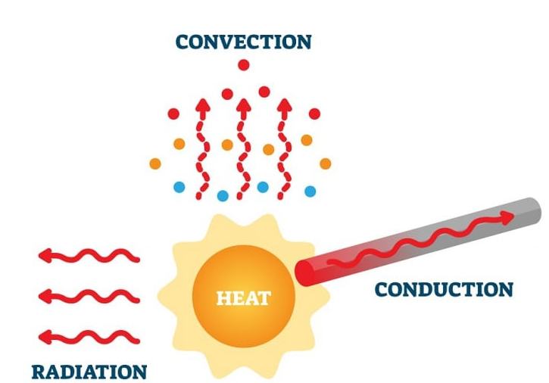

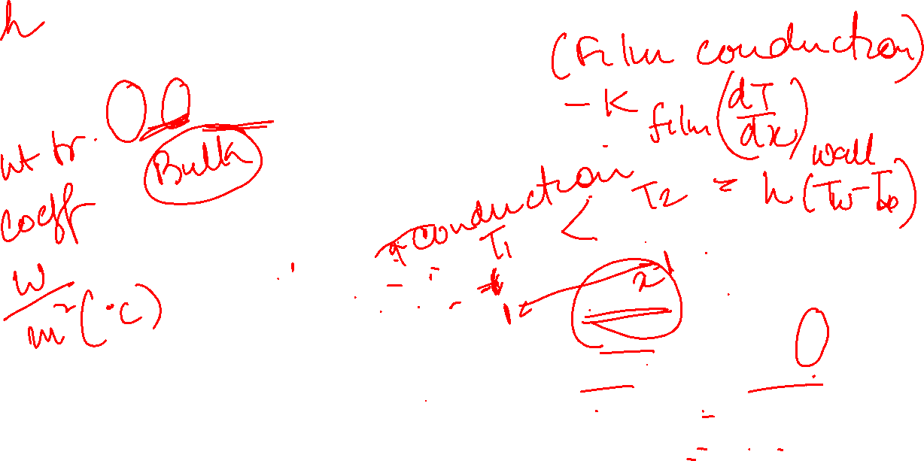
Modes of Heat Transfer
Newton’s Law of Cooling
Fourier’s Law of Heat Conduction
Stefan Boltzmann Law
Heat Flux = q
Heat Rate= Q

Slide 4
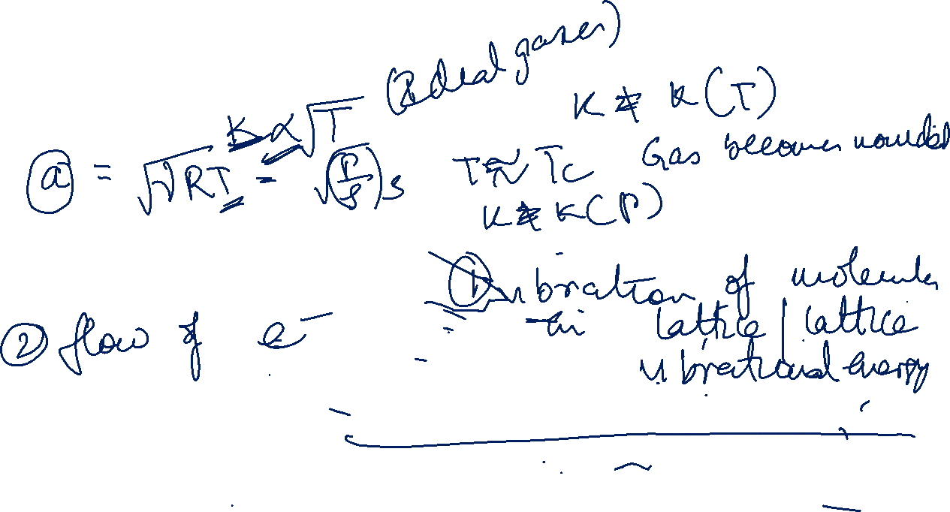
Thermal Conductivity
Unit -
In gases k = fn (T)
In solids thermal conduction by two modes
Good thermal conductors are always good electrical conductors.
Exception
No perfect insulator

Slide 5
Modes of Heat Transfer
Newton’s Law of Cooling
Fourier’s Law of Heat Conduction
Stefan Boltzmann Law
Heat Flux = q
Heat Rate= Q

Slide 6
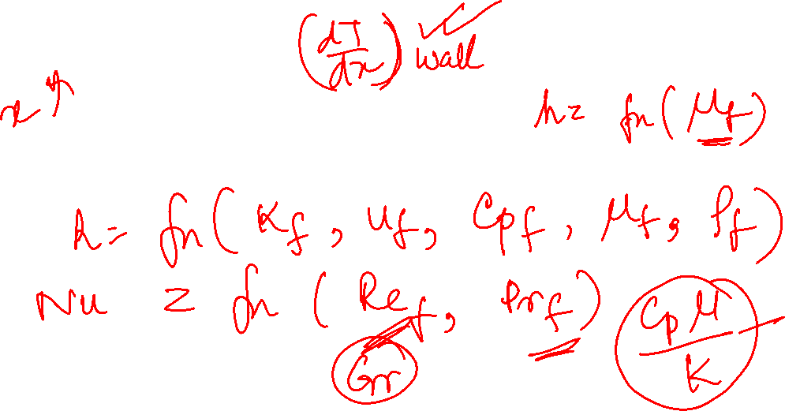
Convection Heat Transfer Process
Newton’s Law of Cooling

Slide 7
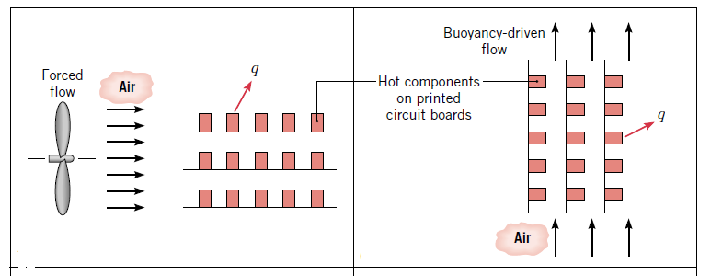
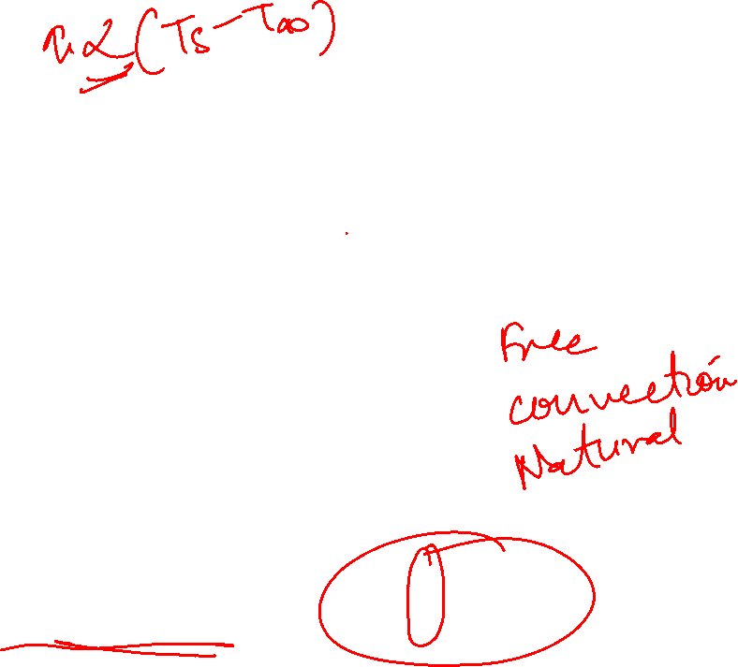
Convection Heat Transfer Processes
Forced Convection
Natural Convection
Regardless of nature of convection,

Slide 8

Convection Heat Transfer Processes
Boiling
Condensation

Slide 9
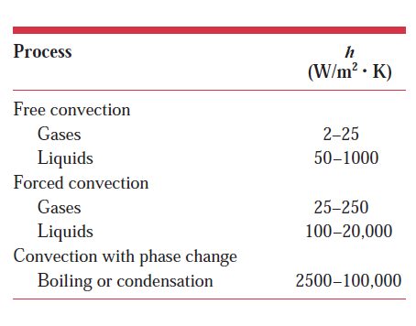
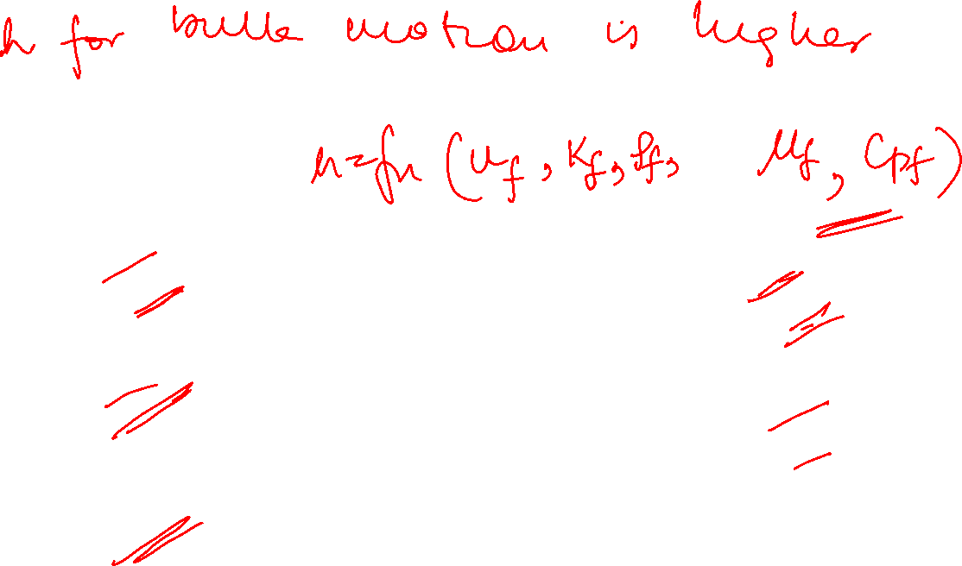
Typical Values of Convection Heat Transfer coefficient

Slide 10
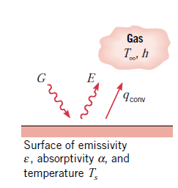
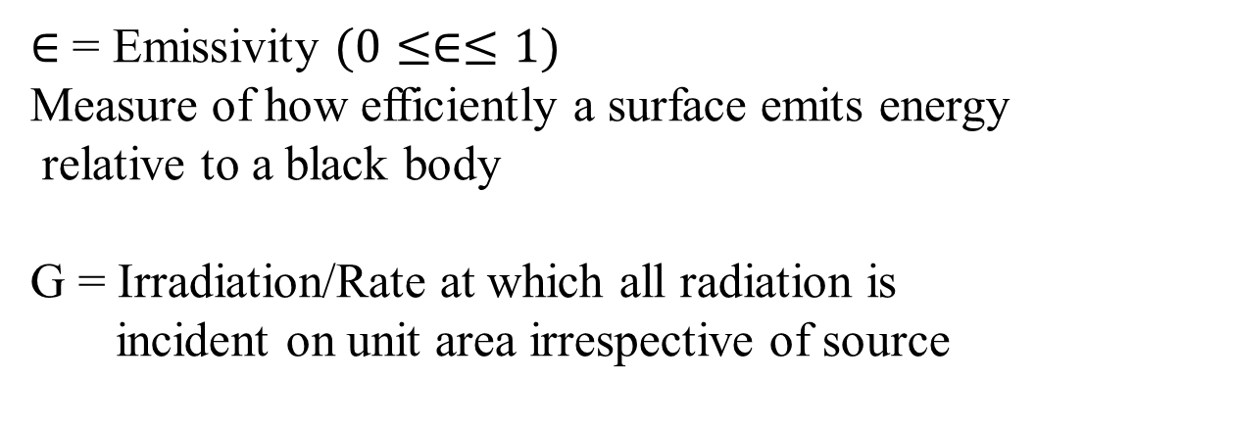

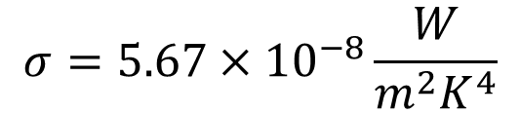

Radiation
E = Surface emissive power = [Rate of energy released per unit area (W/m²)]
Upper limit to E for black body (ideal thermal radiator)given by Stefan Boltzmann Law
$$σ=5.67×{10}^{−8}\frac{W}{m^{2}K^{4}}$$
Heat flux radiated by a real surface =
$∈$ = Emissivity $(0≤∈≤1)$
Measure of how efficiently a surface emits energy
relative to a black body
G = Irradiation/Rate at which all radiation is
incident on unit area irrespective of source
$$(0≤∝≤1)$$
Radiation Heat Loss from a surface

Slide 11
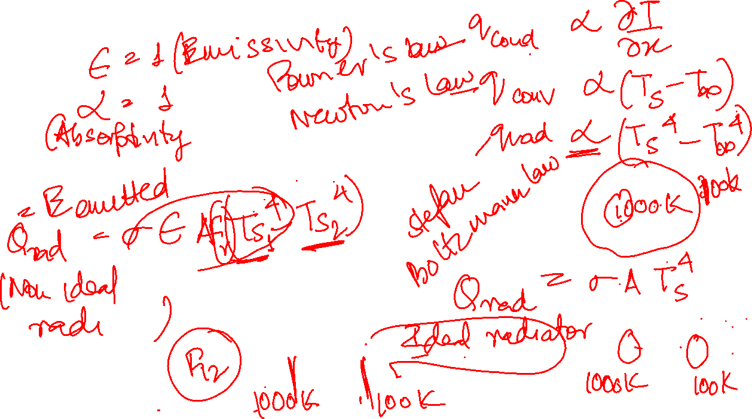
Combination of conduction convection and radiation

Slide 12
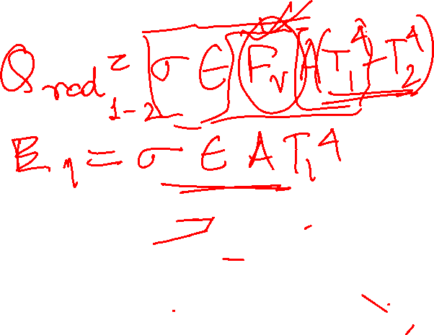
Generalized heat conduction equation in one dimension

Slide 13
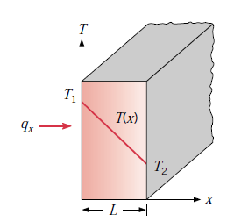
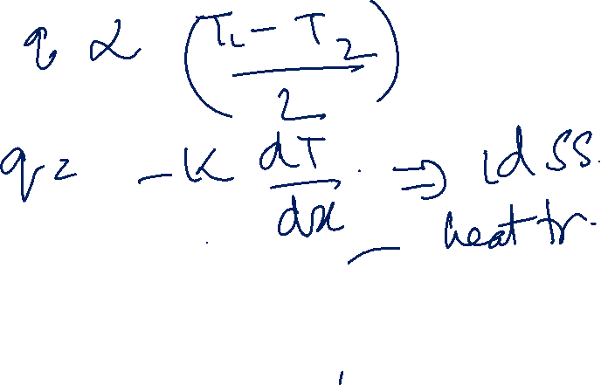
Heat Transfer by Conduction
1d heat transfer by conduction
Q [Heat rate by conduction (W) ]
q = Heat flux /heat transfer rate per unit area normal to direction of heat transfer (W/m²)
k = thermal conductivity(W/m.K) – transport property
Q = Heat rate by conduction (W) =

Slide 14
Heat Transfer by Conduction
1d heat transfer by conduction
Fourier’s Law of Heat Conduction for steady state 1d heat transfer
Phenomenological law
Assuming linear temperature profile, under steady state conditions,
q = Heat flux /heat transfer rate per unit area normal to direction of heat transfer (W/m²)
k = thermal conductivity(W/m.K) – transport property
Q = Heat rate by conduction (W) =

Slide 15
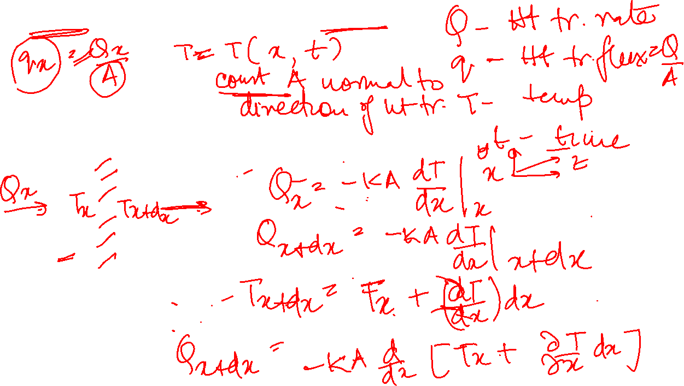
Generalized heat conduction equation in one dimension

Slide 16
Differential control volume (dxdydz) for conduction analysis in Cartesian coordinates
Elemental Volume for 1d heat conduction analysis

